Slide 1
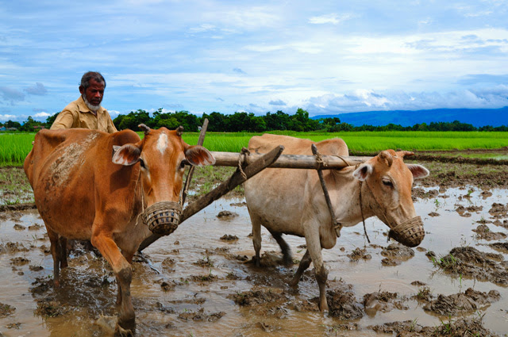
Village Life in Bangladesh
By: Sibrat
Id: 2331560
Fundamental of Computer System

Slide 2
Table of Contents
Introduction
Research question
Research objectives
Research method
Contributions
Description
Data
Results
What did I learn

Slide 3
Introduction
Bangladesh, with its lush green landscapes and fertile deltas, is home to a significant rural population.
Approximately 70% of the country’s population resides in villages, embracing a way of life deeply rooted in tradition and agriculture.
This presentation explores the various aspects that shape village life in Bangladesh, showcasing the essence of their culture.

Slide 4
Research question
What are the socio-economic dynamics and cultural transformations shaping contemporary village life in Bangladesh, and how do these factors impact the traditional social structures and livelihoods of rural communities?

Slide 5
Research objectives
To investigate the traditional social structures and community dynamics that have historically defined village life in Bangladesh.
To examine the impact of urbanization and modernization on the cultural practices and values within rural communities in Bangladesh.
To analyze the role of education and technology in shaping their aspirations and opportunities of villagers in Bangladesh.
To explore the gender dynamics and roles within village households and their evolution in response to changing socio-economic conditions.

Slide 6
Research method
Field Surveys and Questionnaires
In-depth Interviews
Participant Observation
Focus Group Discussion
Document Analysis

Slide 7
Contributions
Socio-Economic Understanding
Cultural Preservation and Adaptation
Gender Dynamics and Empowerment
Policy Formulation and Development
Climate Change and Adaptation Strategies

Slide 8
Description
Village life in Bangladesh is a blend of tradition, resilience, and community dynamics, characterized by close-knit communities, centuries-old customs, and delicate balance between tradition and modernity.
Social interactions thrive in bazaars, festivals, and intimate gatherings, reinforcing cultural ties and strengthening bonds.
Agriculture sustains much of village livelihoods, with fields of rice, jute, and other crops symbolizing seasonal rhythms.
Women, often the backbone of rural households, contribute significantly to household management and agricultural endeavors.
Technology and urban influences have also impacted village life, with young villagers grappling with city lights and heritage preservations.

Slide 9
Data

Slide 10
Results
From the data I collected I wanted to know what people’s opinion is about the life in village nowadays.

Slide 11
What did I learn?
The journey into Village Life in Bangladesh has deepened my understanding of the diverse traditions, challenges, and aspirations of rural communities in South Asia.
The community’s strong bonds and the resilience of women in traditional settings are particularly striking.
The delicate balance between traditional farming practices and modern innovations showcases the adaptability of these communities.
The journey has left me with a profound appreciation for the depth of human connection, the power of adaptation, and the beauty of cultural heritage.

Slide 12
Thank you
Any questions?

